Slide 1
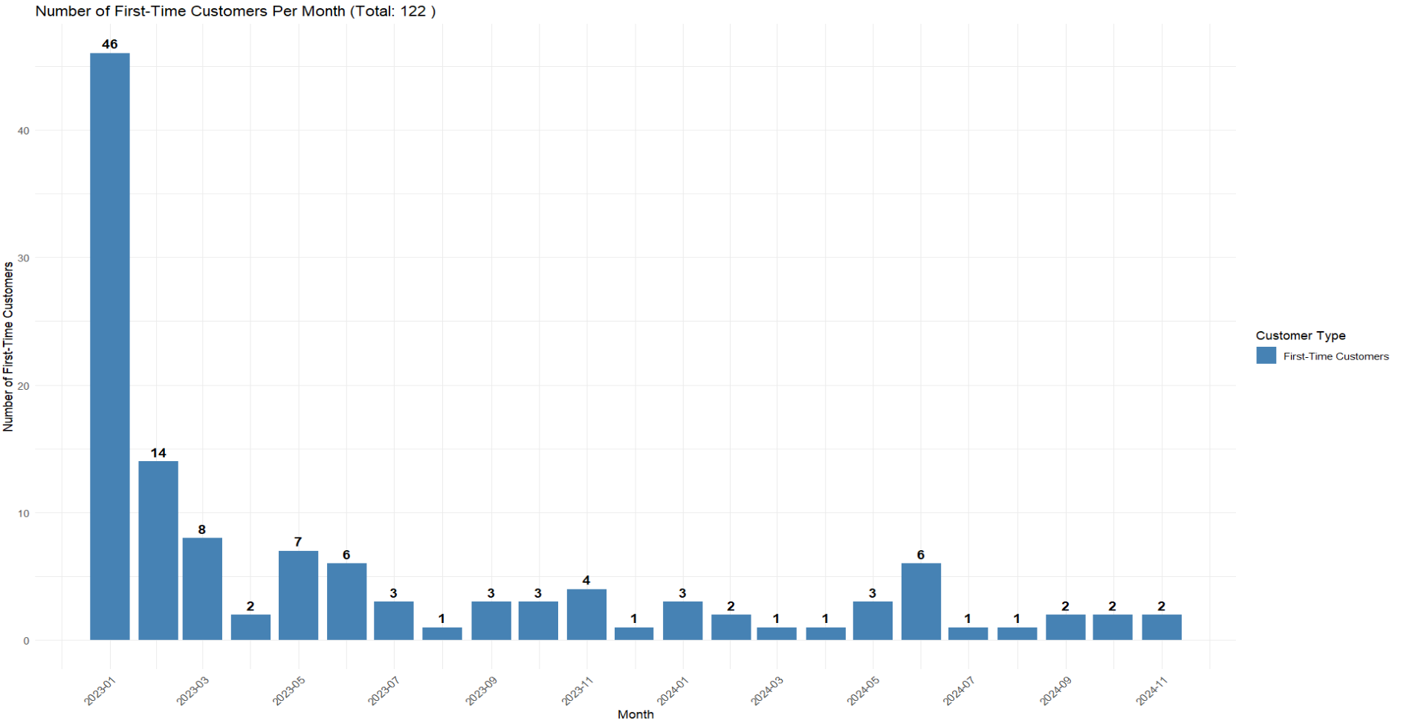

Slide 2
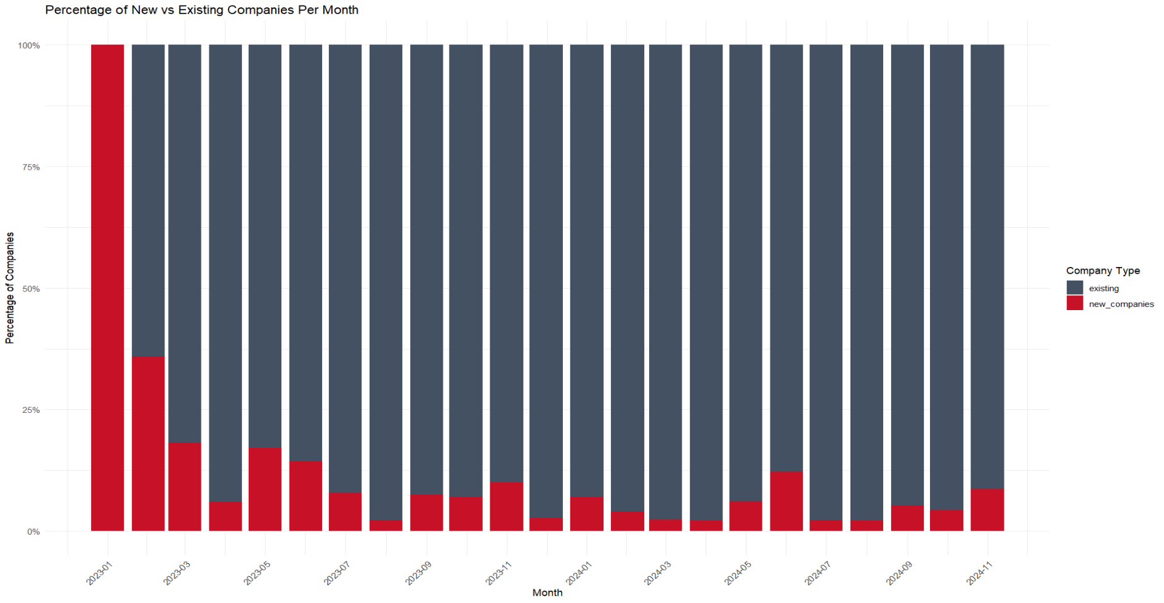

Slide 3
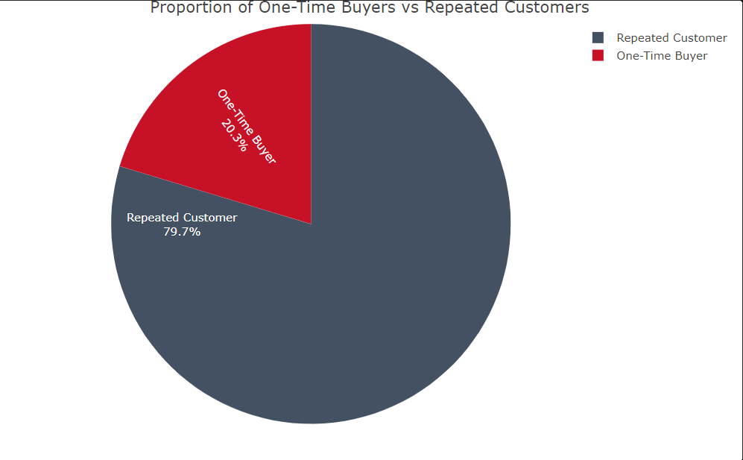
During January 2023-November 2024, one out of five customers did not return

Slide 4
Interactive table of one-time buyers and ordered parts( one per part)
omp_customer_organization_id | jmp_part_short_description
A001-AIRTE | 820222 BRACKET, ROD CYLINDER MOUNT
A007-ATR | 13067-001 REV B BRACKET TRANSFORMER MTG ****OFFERI
A055-AIG | 8600D-003 back plate
C037-CHRKE | P-0001019428
C037-CHRKE | P-0001019433
C048-C&CFA | F-2019MP-02
F019-FSM | MS-402 MS-3 EXTENDED BEAM BASE
F019-FSM | SETTLESTOP WALL BRACE BRACKET ANG MS-501
F024-FMW S | 11961 .188 HRPO 107.18 X 70.0016
F024-FMW S | 11962 .188 HRPO 14.9375 X 57
F024-FMW S | 11963 .188 HRPO 12.125 X 57
H033-HERM | sk-22439-1 plate **BEND ONLY**
I014-INDUS | 221-5-518 Final Machining
J006-JSPRM | LASER ETCHED TAGS 14 GALVANIZED
K008-KINGI | level sensor clip
K009-KOMAT | 2A56222340NK
K009-KOMAT | PAINT FEE FOR 20Y3044191XC
L017-LINCO | SH-0001 1MM SHIM (FOR CLAMP ARMS)
L019-LEEMN | 4367-01
L019-LEEMN | 4367-01-F
L019-LEEMN | 4367-02
L019-LEEMN | 4367-03
L019-LEEMN | 4367-07
L019-LEEMN | 4367-08
L019-LEEMN | 4367-17
L019-LEEMN | 4367-18
L019-LEEMN | 4367-20
L019-LEEMN | 4367-28
L019-LEEMN | 4367-30
L019-LEEMN | 4367-34

Slide 5
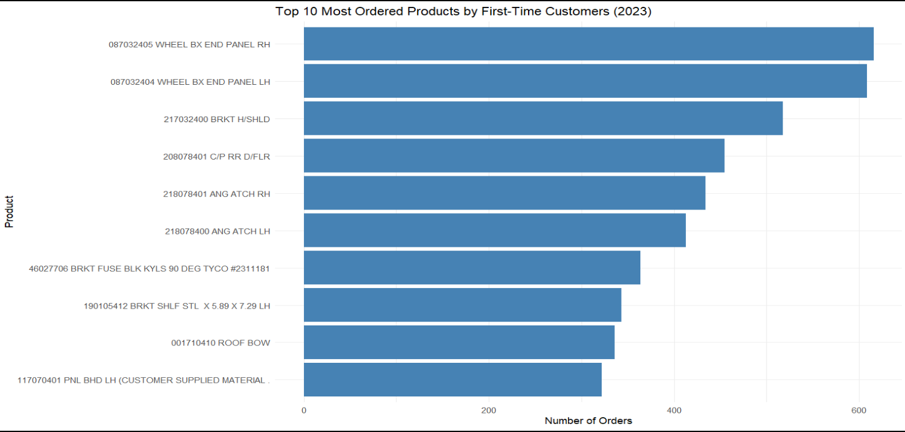

Slide 6
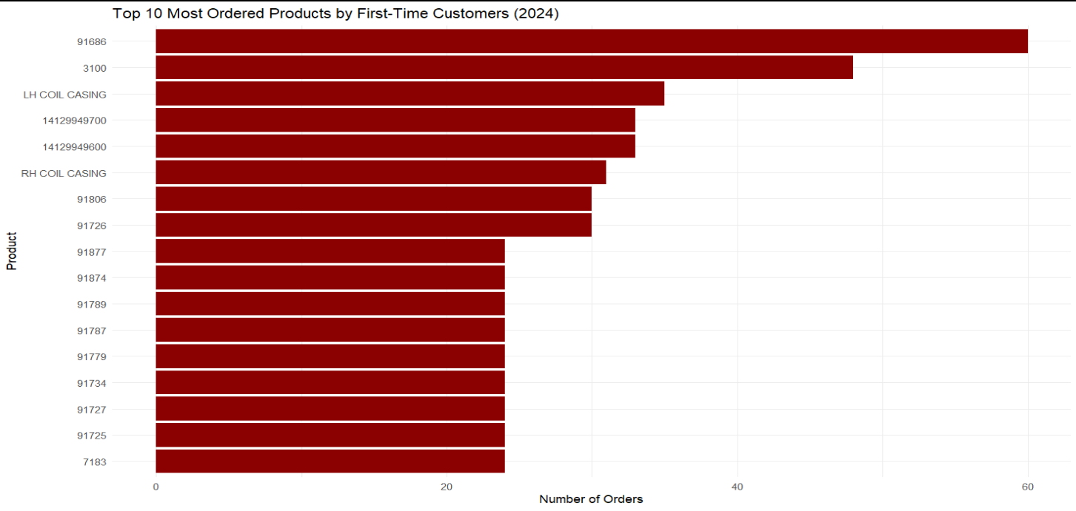

Slide 7
